Slide 1
FIRE DETECTION & ALARM SYSTEM FOR RESIDENTIAL AREA
Presented By:
Md.Qamrul Hasan :2018200000031
Jannatul Feardous:2018200000020
Mahfuza Khondokar Rifath:2018200000028
Presented To:
Mr. Ovishake sen
Lecturer , Southeast University

Slide 2
Problem Statement:
Now a days we can see a lot of fire occurred in residential area. So we realize that we need a automated fire detection system.

Slide 3
Purpose of project:
Our system provides an early warning of fire so that people can be evacuated & immediate action can be taken to stop or eliminate of fire effect as soon as possible.

Slide 4
Working Procedure:
Detect Fire
Alert Occupants
Manage Risks
Notify Authorities

Slide 5
List of Equipment:
Arduino
Breadboard
Temperature sensor
Smoke sensor
Buzzer
LED
Resistor
Relay SPDT (Single Pole Double Throw)
Bulb
Power Supply

Slide 6
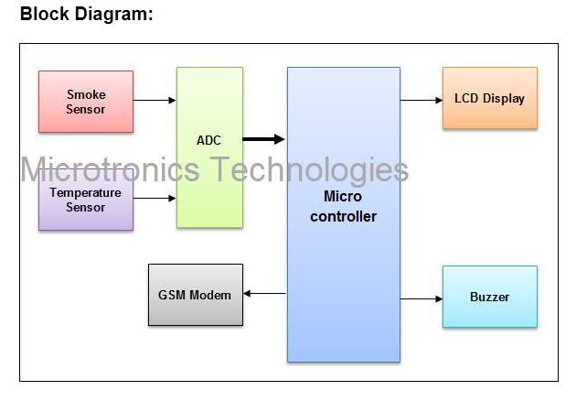



Slide 7
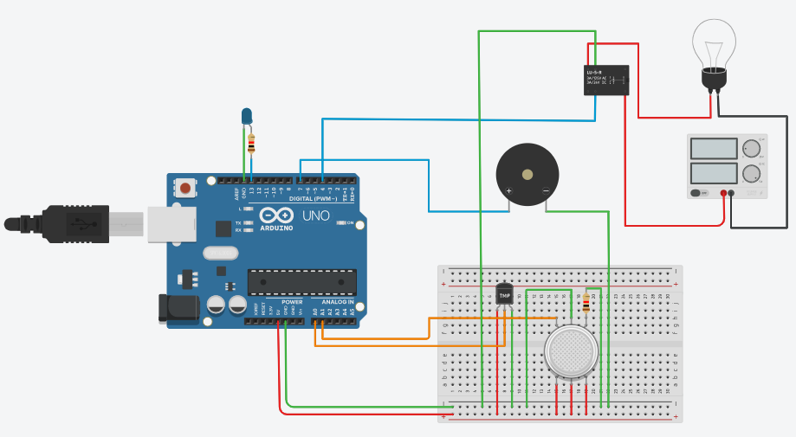
Circuit Diagram:

Slide 8
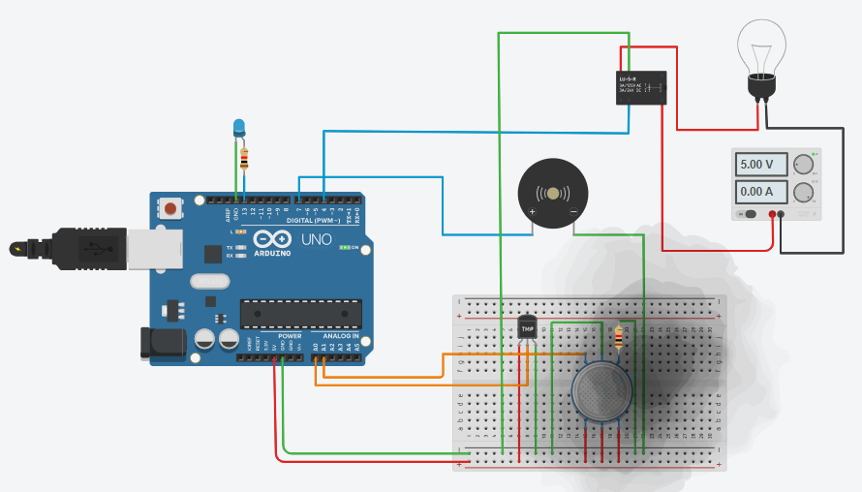
Circuit Diagram with Simulation:

Slide 9
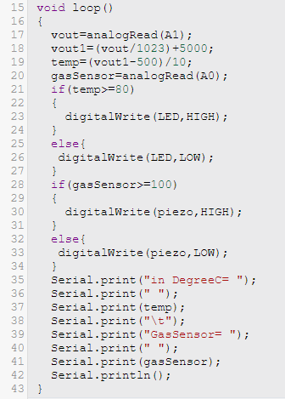
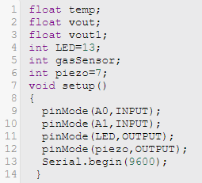
Code Segment:

Slide 10
Advantages Disadvantages
Sensing of fire (Heat) easily
Simple Circuit
Low Power Consumption
Low Cost
Senses near by the fire(only)
User Continues power supply

Slide 11
Future Scope :
To overcome disadvantages of this project
Using warning message & audio alert signal instead of buzzer.

Slide 12
Conclusion:
Hence, the project fire alarm system was designed and implemented successfully. By using this, we can detect the fire break out in a short period and also can notify to the people who live in given area.

Slide 13
Thank for your valuable attention ! Feel free to ask questions , if any.

